Slide 1

CSCI 636
Big Data Presentation
Kevin Chow 1266346
Joseph Heaney 1264159
Rex Ocampo 1266096

Slide 2
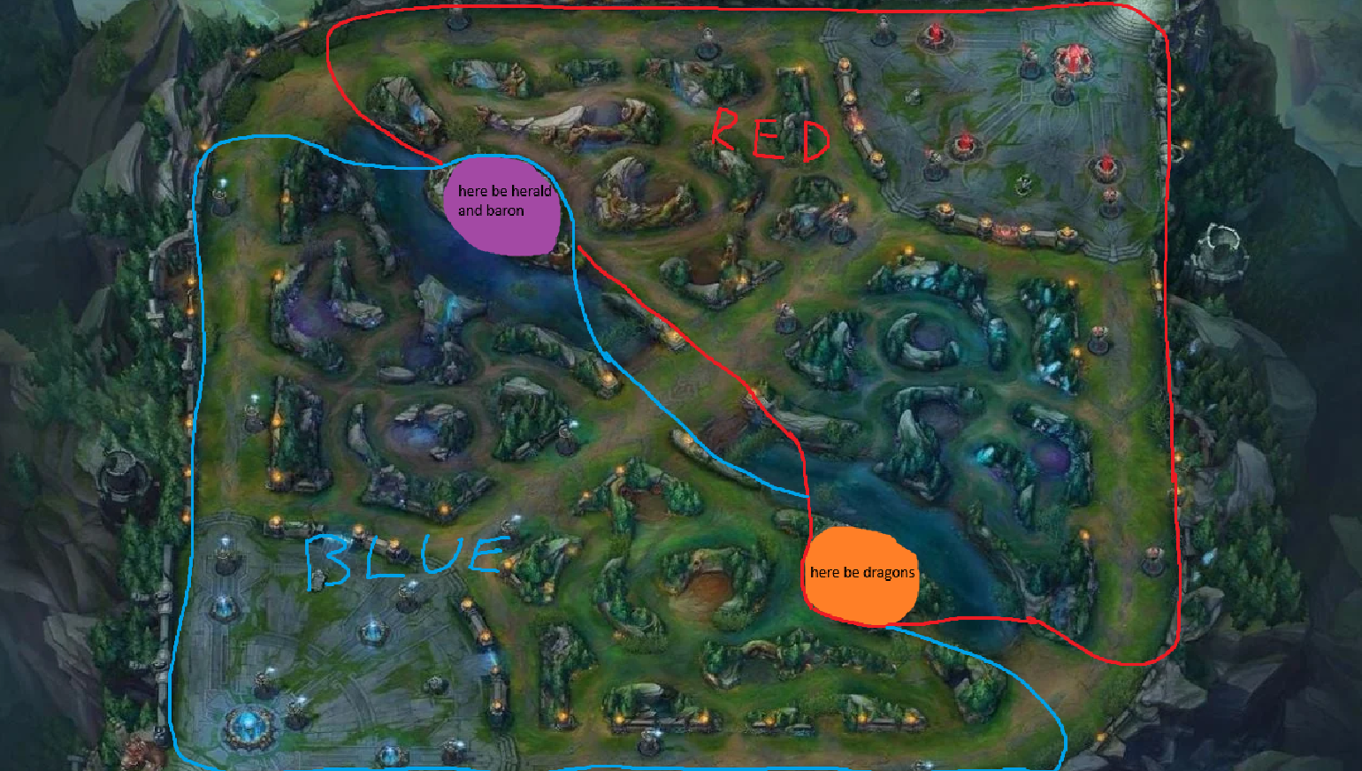
About the Game
League of Legends (LoL) is a team-based strategy game
10 players split in two teams (Blue and Red) and pick champions with distinct strengths and weaknesses
The objective of each team is to work together to destroy the enemy Nexus (Located top left and top right of the map).
During the game, players secure objectives that buffs their team or obtains gold in which players use to buy items and make their champions stronger

Slide 3
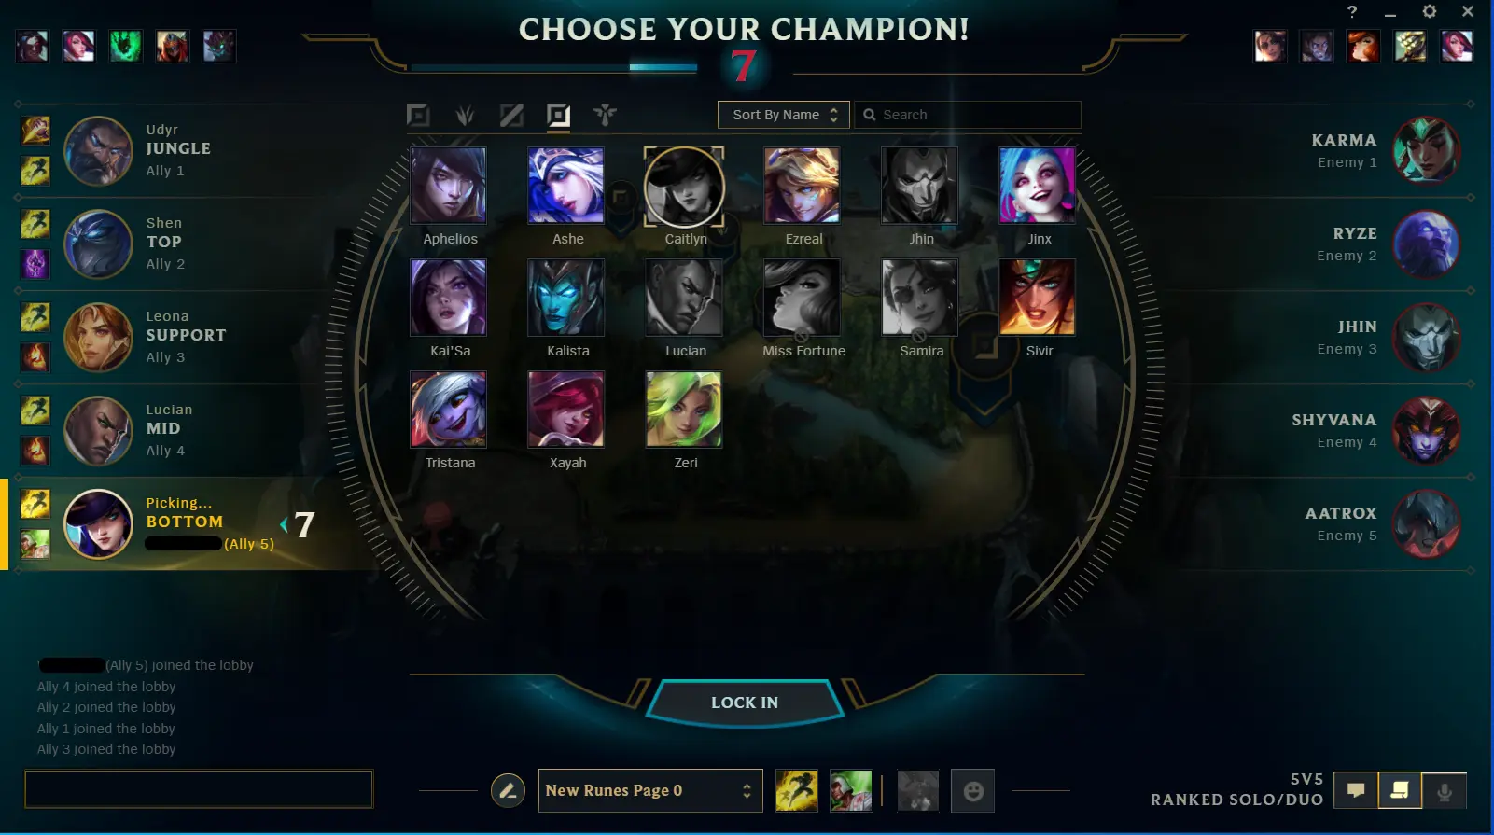
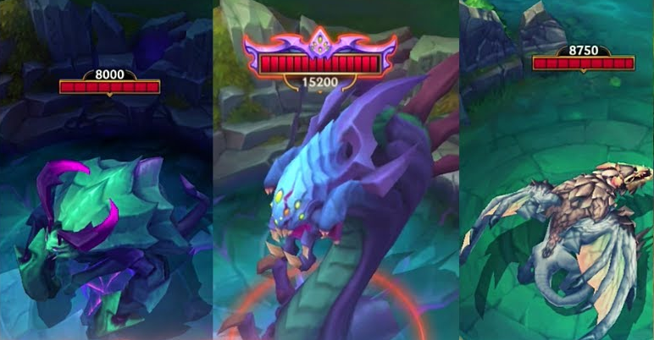
Is The Game Blue Side Favored?
Since the game was released, there are ongoing rumors that the game favors the players on Blue Side
Blue side has the first pick and ban for champions in drafting
While Red Side has the last pick for counterpick
Blue side favors top side objectives, the Rift Herald and Baron objectives (Early and Late Game objectives)
While Red Side favors bottom side objective, the Dragons.
Blue has a slight advantage in early (First Herald), mid (champion draft), and late (Baron) game
Blue side camera angle is “subjectively better” due to isometric view

Slide 4
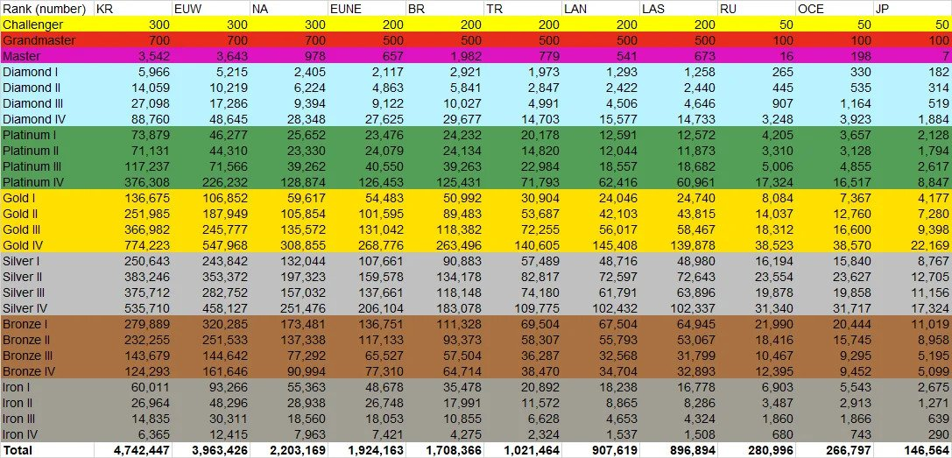
Season 10 player population
Source: https://www.reddit.com/r/leagueoflegends/comments/jrkuqn/end_of_season_10_ranked_population_distribution/

Slide 5
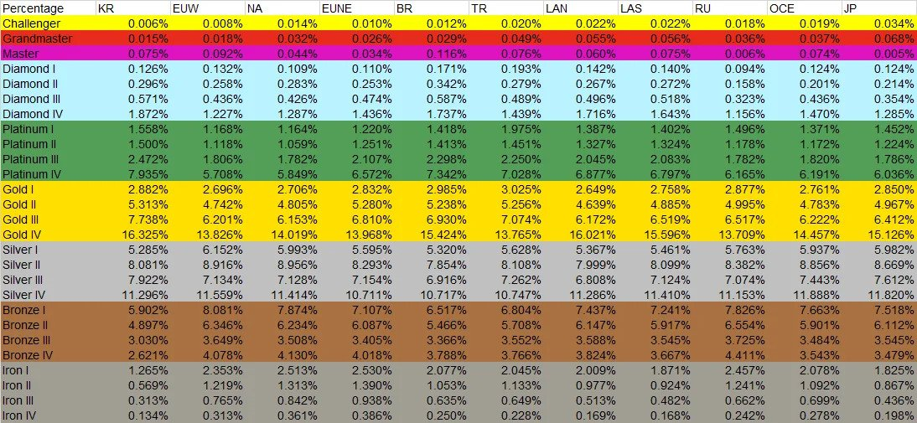
Season 10 player percentage
Source: https://www.reddit.com/r/leagueoflegends/comments/jrkuqn/end_of_season_10_ranked_population_distribution/

Slide 6
Questions we want answered
By analyzing the top 1% of the ranked ladder,
Three key questions we want answers to are:
Does starting side play a role in winning the game?
Is there a difference in priority between starting side and their ‘intended objective’ (Blue for Herald and Baron, and Red for Dragons) ?
What are the key variables for a side to take in order to have a higher chance of winning the game?

Slide 7
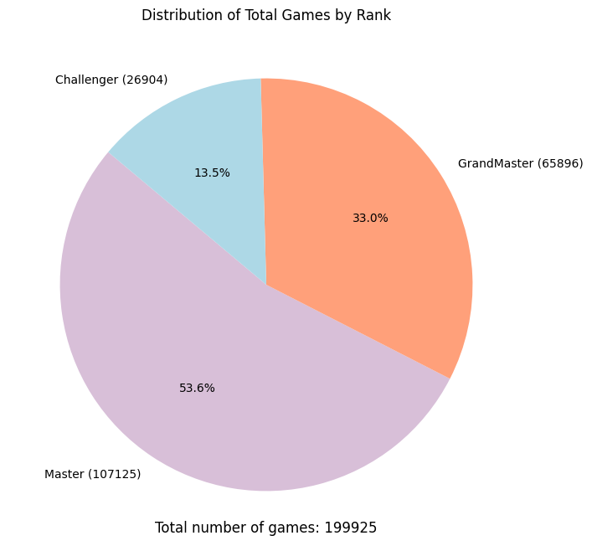
Dataset Used
Dataset used was sourced from Kaggle and recorded data across the top 3 ranks in the game (Challenger, Grand Master, and Masters) from 2020
Dataset consists of 200k observations (rows) with 50 features (columns)
Blue side variables will be used since our target variable is blueWin
Important variables that we will focus on are . . .
Outcome: blueWins
Game Length: gameDuration
Player Performance: blueKills, blueDeaths, and blueAssists
Resources: blueTotalGold
Objectives: blueDragonKills and blueBaronKills

Slide 8
Data Lake vs Data Warehouse
Before planning on what infrastructure or service to use, we have to decide if a data lake or a data warehouse should be used
Both have their merits, such as
Data Lake:
Ability to take in raw and unstructured data
On-demand data processing
Costs associated are inexpensive
And Data Warehouse:
Ability to take structured and pre-processed data
Optimized for complex queries and aggregation
Our Choice? Data Lake
Data Lake was the best choice for our needs, and the added benefit of having a Data Lake service within AWS
Prefer AWS as IaaS due to having prior experience with the AWS infrastructure
All of needs are located within AWS
S3 to hold our Data
Glue for Data ETL and Database creation
EMR to run Spark Jobs
Athena for SQL queries
Lake Formation to create our Data Lake
Cloud Formation to streamline the entire process

Slide 9
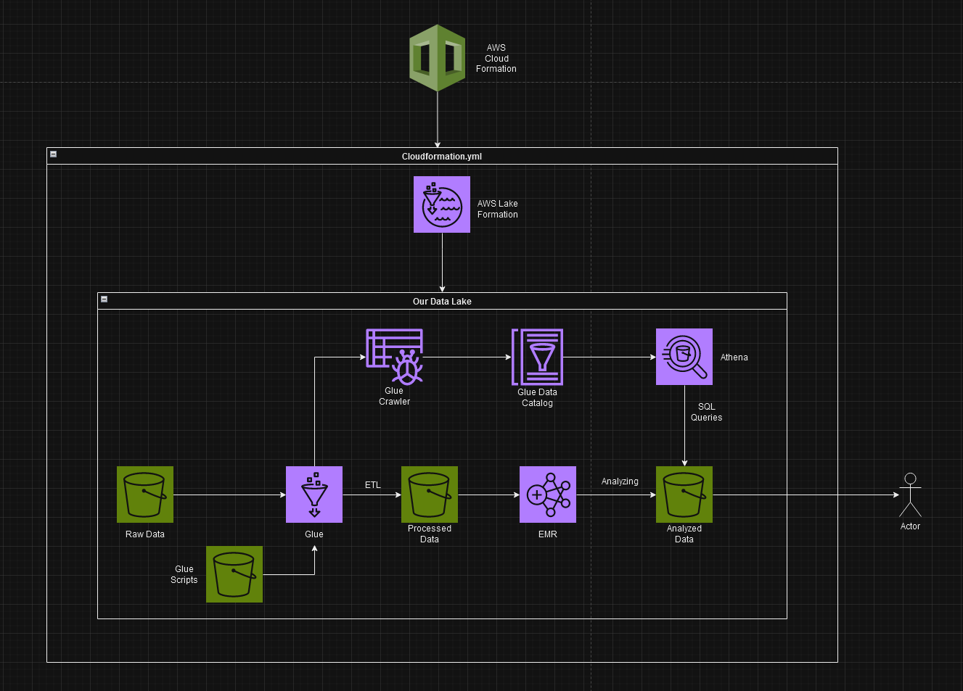
Architecture System Design Diagram

Slide 10
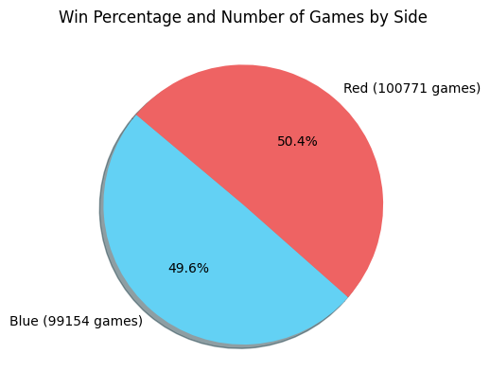
Initial Analysis Of Win Rates
For the initial analysis, we combined all three .csvs files of the top 3 ranks and focused on two variables, blueWins vs redWins
In total, across 3 different ranks, the graph is split nearly evenly
This means that the statistics is initially showing that blue side does not have a significant advantage in which can be used to impact the game

Slide 11
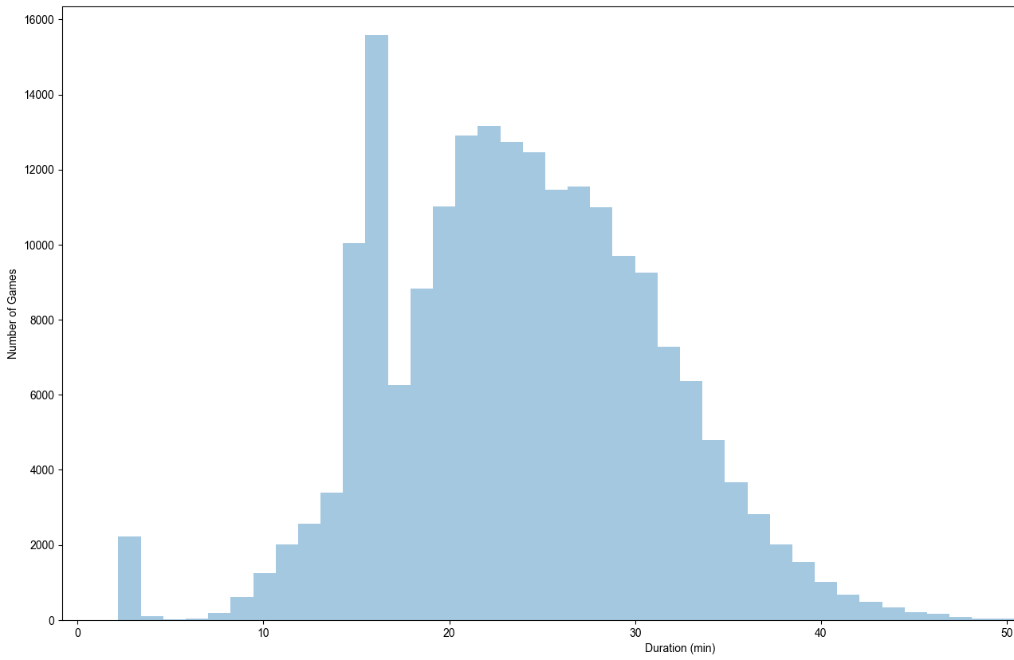

Analysis Of Game Duration
The average game length is approximately 24 minutes.
At 3 minutes, we can see a small spike which can be explained by the game allowing players to surrender due to a AFK or disconnect due to internet issues
The biggest outlier is 1~5 - 17 minutes which is when the surrender feature is normally used. A vote of ⅘ players on a team may choose to surrender at this point due to losing important early game advantages
The average game length is ~24 minutes because the baron is first spawned at 20 minutes.
Defeating the baron gives the team a massive buff (power increase) for 3 minutes or until they die. On the other hand, the baron is hard to defeat and the enemy can wipe your team due to taking a lot of damage already from the baron.
This graph shows the importance of objectives in determining a side’s ability to win either by snowballing or forcing the opposing side to surrender

Slide 12
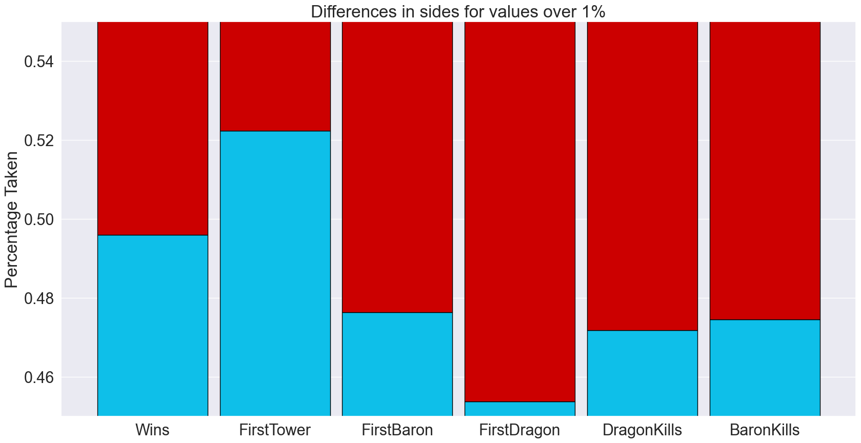
Side vs First Objectives Taken
This graph shows the percentage of which sides are obtaining/prioritizing different objectives
Here we can see how the asymmetrical map affects which side is slightly favored due to proximity of objectives
First, we can see how blue side is favored for firstTower. This is because blue side has better access to the herald which when summon, attempts to charge into the nearest tower and doing massive damage to the tower.
Secondly, the red side heavily favorites the firstDragon. This is not only because the red side has better access to the dragon, but also because dragons typically are less beneficial when compared to the herald in the early game.
Lastly, red side is slightly ahead in firstBaron and baronKills. The baron is located closer to red side with blue side having easier access to it. However, as explained in the last slide, baron is much more dangerous and risky to defeat while granting massive buffs
This graph shows that while win rates are nearly even, each side does have its own benefits and disadvantages that evens out the win rates of each side.

Slide 13
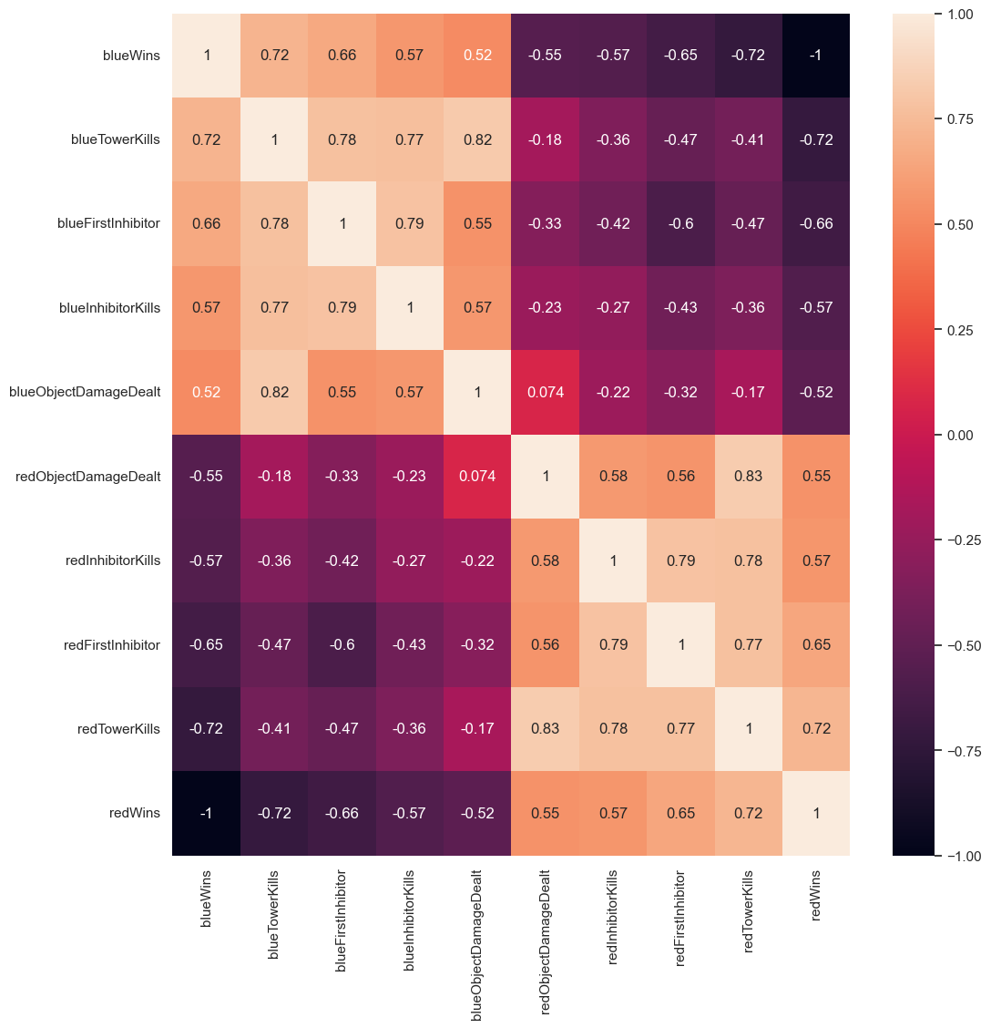
Win Correlations Using Heat Map
This graph shows the correlation between structural objectives (inhibitors/towers) and winning
The lighter the shade is, the stronger the correlation between that specific x-variable and its respective y-variable
From the heat map, we can see that the primary variable that defines which side wins is the amount of TowerKills and InhibitorKills. This is due to the fact that when these objectives are taken, the team is literally closer to destroying the enemy’s Nexus (base) which is the primary base
In other words, knowing how to win is very obvious for both sides, reach the enemy Nexus and destroy their base by going through towers and inhibitors
Instead, let's focus on the other variables that correlates less towards a win…

Slide 14
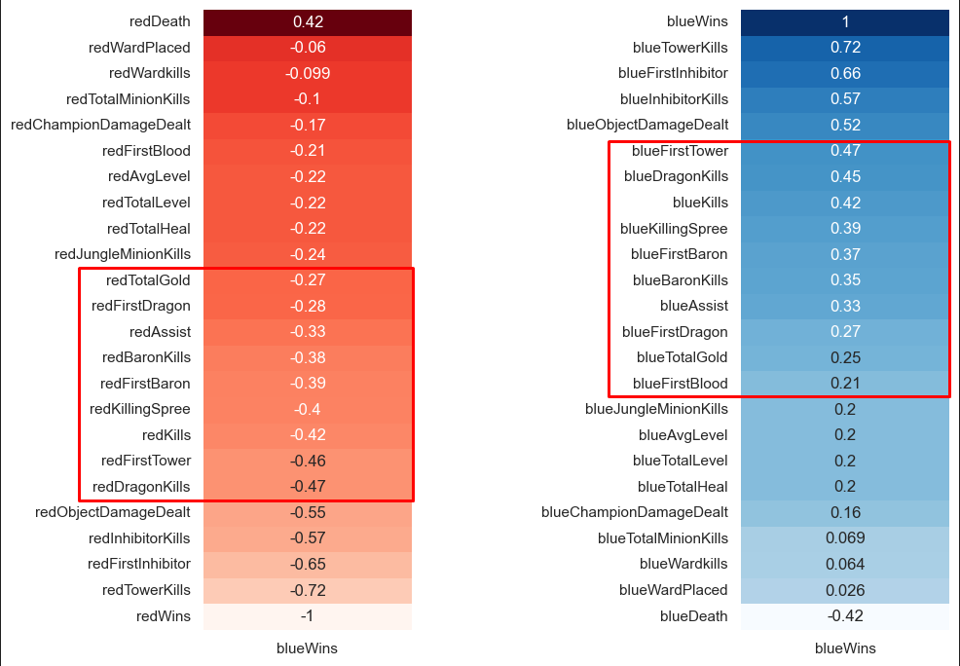
Neutral Objectives and Win Correlations
This graph shows the correlation between various neutral objectives and game events to winning
Objectives are the most important to secure because they provide the team with buffs and gold. This leads to having a higher chance of taking towers and inhibitors because your champion being stronger through buying items with the gold obtained
More of everything, except deaths, gradually increases the chances of a side winning
Both side’s win correlations are nearly identical but inverted
The best way to win is to destroy towers and inhibitors. In order to destroy structures, a combination of neutral objectives (dragon, herald, and baron) will contribute the most

Slide 15
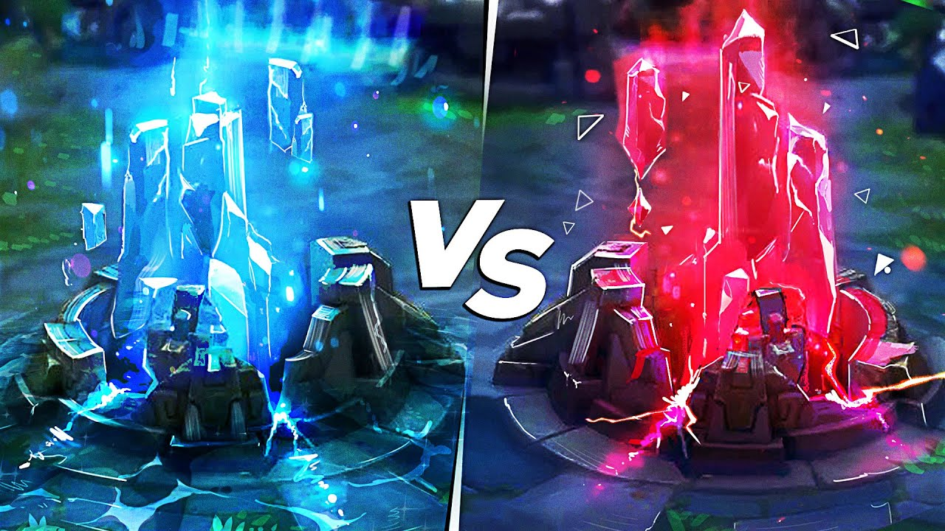
Conclusion
Taking what we learned from analyzing the top 1%, we can say
League is not blue or red side favored
Both blue and red side has advantages and disadvantages that balances each other out in the context of ranked matches
In ranked League, the side a player starts with should not matter.
What matters are the amount of neutral objectives each team obtains
Note: This data analysis was done on games played in 2020 consisting of the top 3 ranks.
This does not represent past or future years where changes to champions/items/maps (Meta) may prove to favor one side over another

